Slide 1
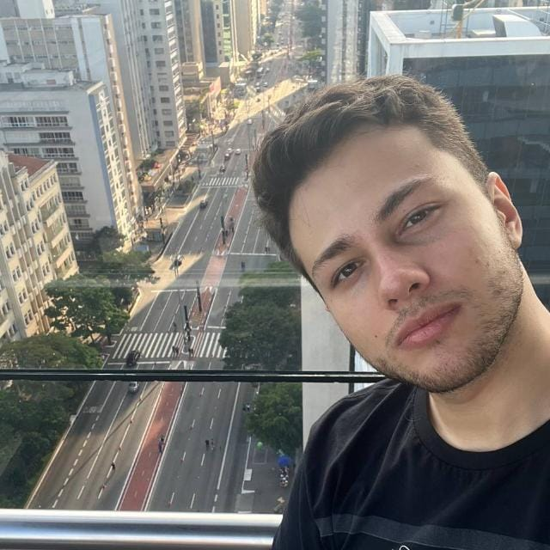
Who am I?
My name is Lucas Monteiro
I’m 24 years old
Originally from Barretos - SP

Slide 2
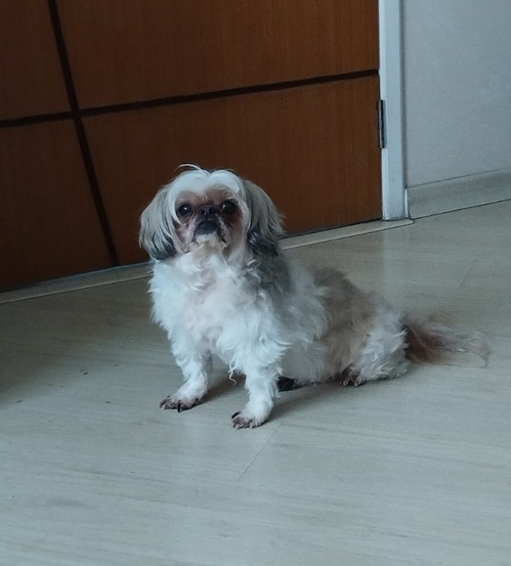
Home
Currently I live the Central Zone of São José dos Campos with my parents, my younger brother, and my dog Max.

Slide 3


Studying
I have studied English for 6 years, so I’m almost fluent in English. I just have to keep in touch with the language to not forget it.
I also studied a little bit of German for 3 years, but I can only speak just really basic German.

Slide 4

Working
I was a Municipal Census Agent, working in the Administrative and Management area.
I had a team of about 50 people reporting to me, we together worked in the East Zone of São José dos Campos.

Slide 5

Working
I have worked at IBGE (Brazilian Institute of Geography and Statistics) for the last year from Jun/2022 to Jun/2023 in the Census Operation.

Slide 6


Hobbies
As hobbies I may say that I like watching movies and series.
As well as reading and collecting Comic books.

Slide 7

Dreams of…
Getting my degree;
Getting a good job;
Traveling the world;
Become a polyglot.

Slide 8
THE END

